Slide 1
GTU CSE 495
UNDERSIGHT
Detecting the Suspicious Object on Vehicle Underbody Images
MUSTAFA BERKAY BAYGUT
1901042633
Proje Danışmanı: Doç. Dr. Habil KALKAN
ARALIK 2023

Slide 2
Content
Project Summary
Algorithm Details
Where I am?
Where will I be?
Sample outputs
Sources

Slide 3
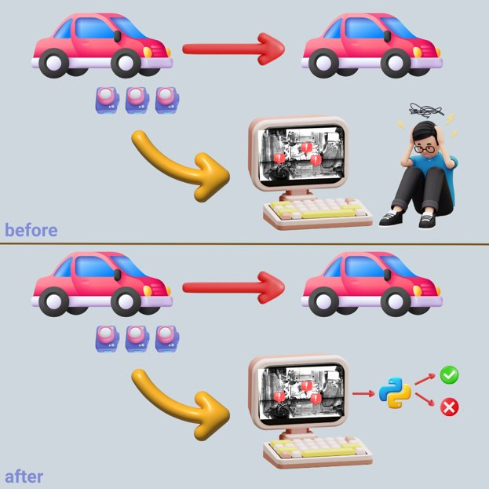
Project Summary
UNDERSIGHT
“Undersight” is a secure gate keeping algorithm to detect suspicious object undercarriage images of the car.
First it process the images to check if there is a suspicious object or not.
After it locates the where objects is.

Slide 4
Algorithm Details
At the beginning clean undercarriage image of cars will be registered.
Second, cached clean data will be set and ready to detect images.
Incoming images can be shifted by any direction. So image registration handled by first phase.
At the third phase regardless from altered image, control image and target image subtract from each other to detect the image.
Last part is subtracting and detecting the suspicious object.

Slide 5
Where I am?
I can easily detect the suspicious object if the image not shifted by subtracting images each other with comparing photos pixel-wise.
I can register the photo with BFMatcher.
I can’t do these two parts together for now.

Slide 6
Where will I be?
I will register the photo and detect the differences between clean and suspicious images until the next presentation.

Slide 7
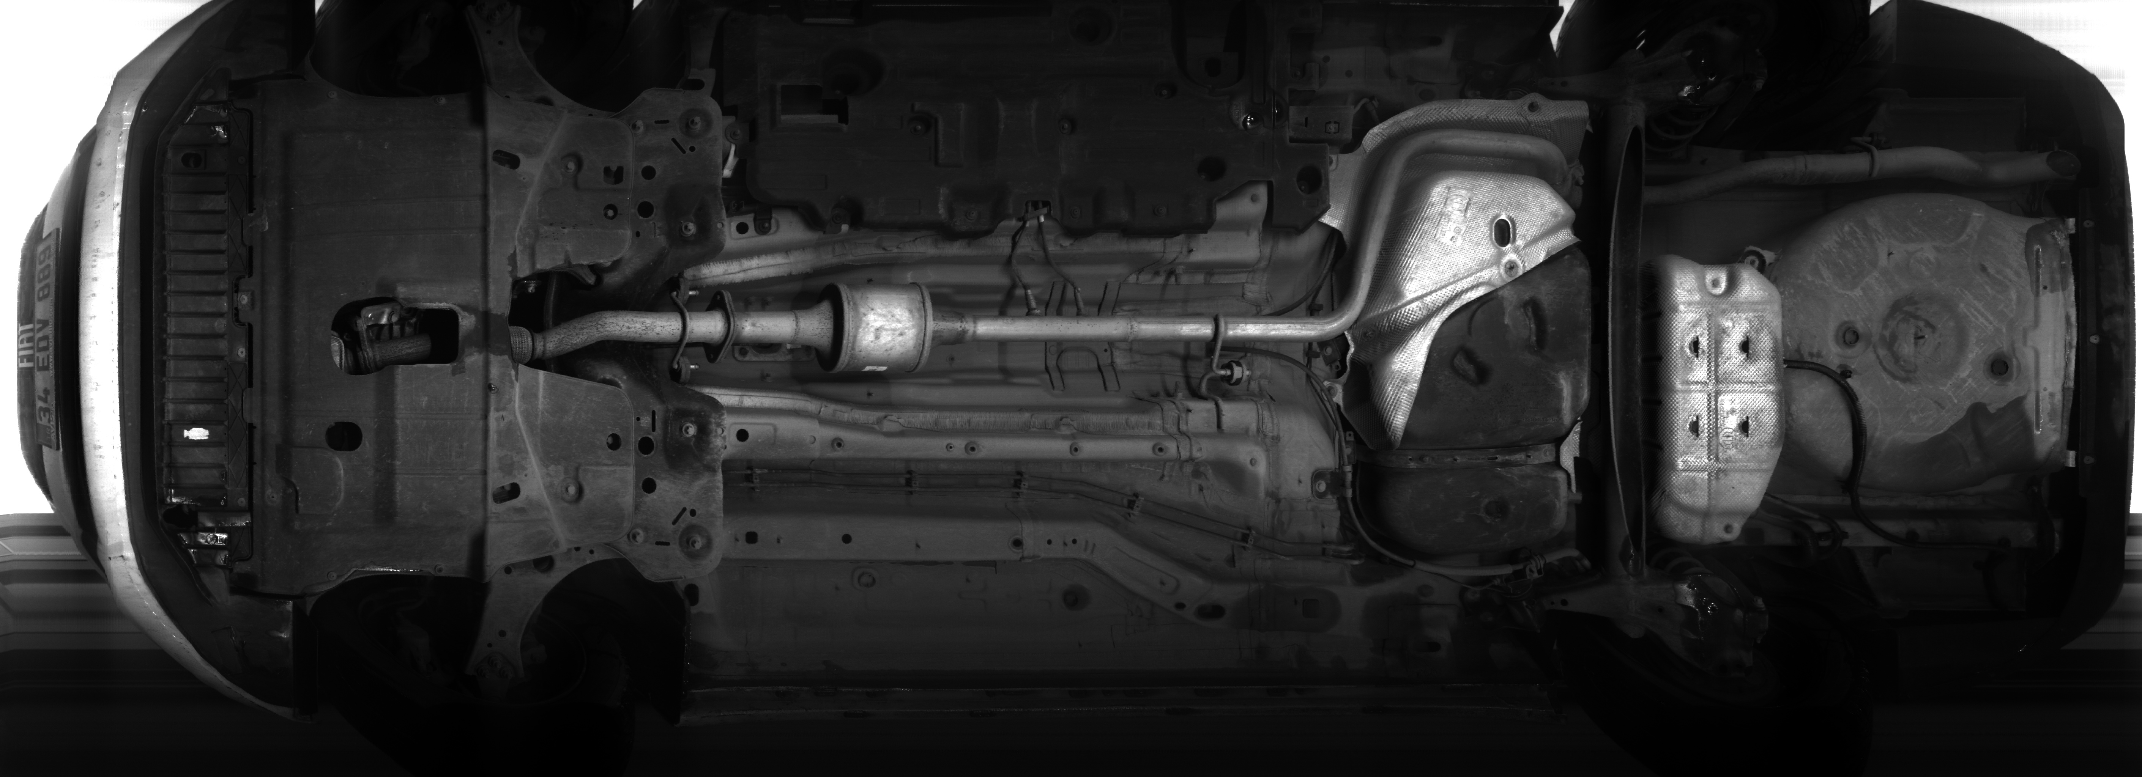
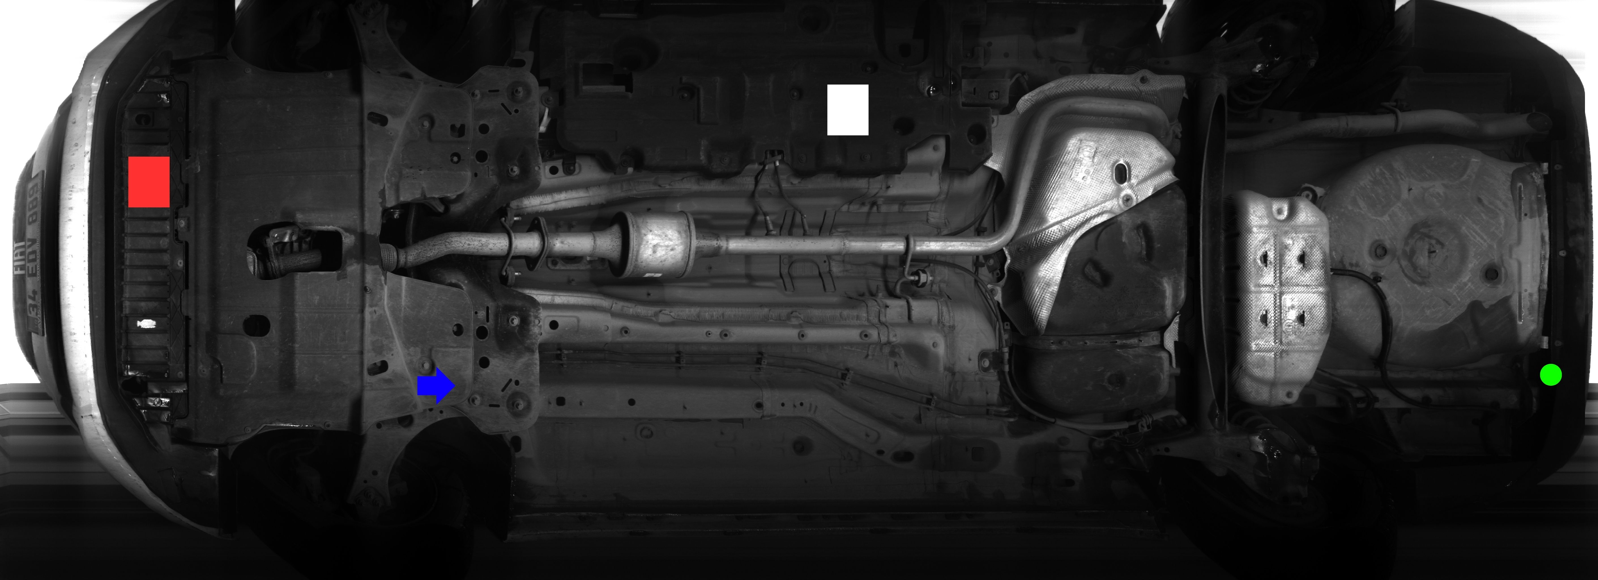
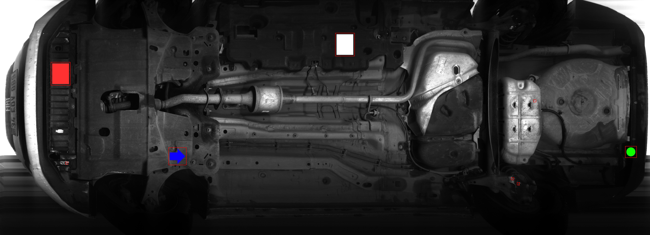
Sample Outputs for Detecting Suspicious Objects
CLEAN
SUSPICIOUS
FINAL

Slide 8
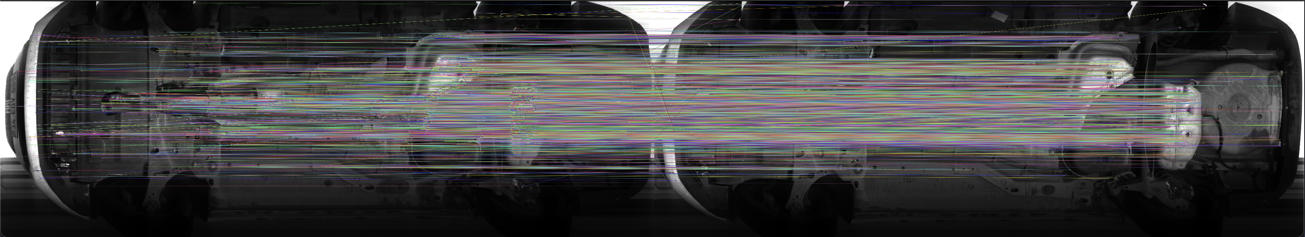
Sample Outputs for Image Registration
8

Slide 9
Sources
IVUS Gatekeeper Security, https://www.gatekeepersecurity.com/products/intelligent-vehicle-undercarriage-scanner/
Vehicle Undercarriage Scanning System, https://sear.unisq.edu.au/536/1/frederickCHONGchuenkiong-2005.pdf

